Slide 1
MARKETING ANALYTICS I
SESSION 14:
MARKET SIZING
AND NEW PRODUCT ADOPTION
UT Austin MSBA Program
Professor Sonnier
Fall 2022

Slide 2

MARKET SIZING AND NEW PRODUCT ADOPTION
Consider the iPhone

Slide 3

MARKET SIZING AND NEW PRODUCT ADOPTION
When Will A Consumer Adopt?
Years
XXX
XXXXXXXXX
XX
1 2 3 4 5 6 7 8

Slide 4
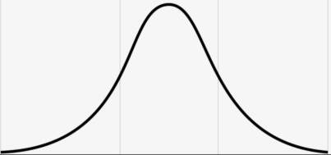
MARKET SIZING AND NEW PRODUCT ADOPTION
Time to Adoption
Let’s say time to adoption is normally distributed with mean 5 and standard deviation 1.
Years
1 2 3 4 5 6 7 8 9

Slide 5
MARKET SIZING AND NEW PRODUCT ADOPTION
Cumulative Adoptions
Cumulative sales reach upper limit by later time periods
Curve exhibits an inflection point at which the sales increase begins to decrease

Slide 6


MARKET SIZING AND NEW PRODUCT ADOPTION
SOME POSSIBILITIES TO CONSIDER
How to model cumulative sales, adoptions, users, etc.

Slide 7
MARKET SIZING AND NEW PRODUCT ADOPTION
CURVE FITTING
Cumulative sales of a product
Pearl Curve
M is market size
a and b are parameters
t is time

Slide 8
MARKET SIZING AND NEW PRODUCT ADOPTION
iPod Sales

Slide 9
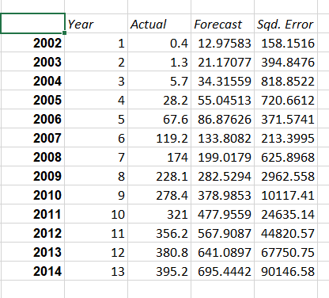
MARKET SIZING AND NEW PRODUCT ADOPTION
iPod Sales

Slide 10
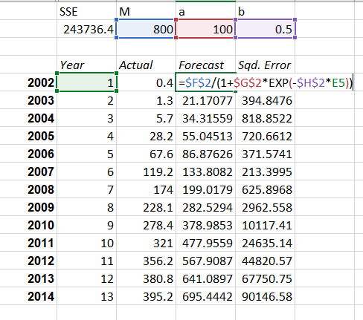
MARKET SIZING AND NEW PRODUCT ADOPTION
iPod Sales

Slide 11
MARKET SIZING AND NEW PRODUCT ADOPTION
iPod Sales

Slide 12
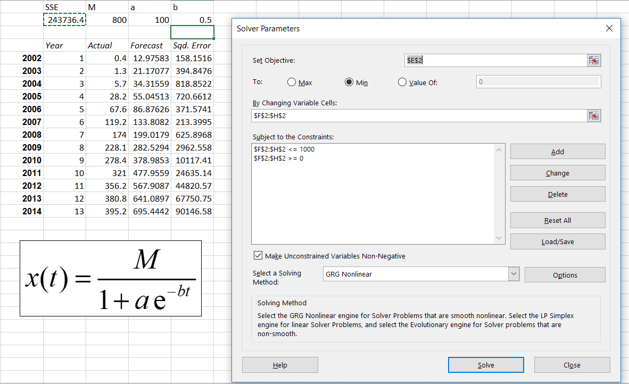
MARKET SIZING AND NEW PRODUCT ADOPTION
iPod Sales

Slide 13
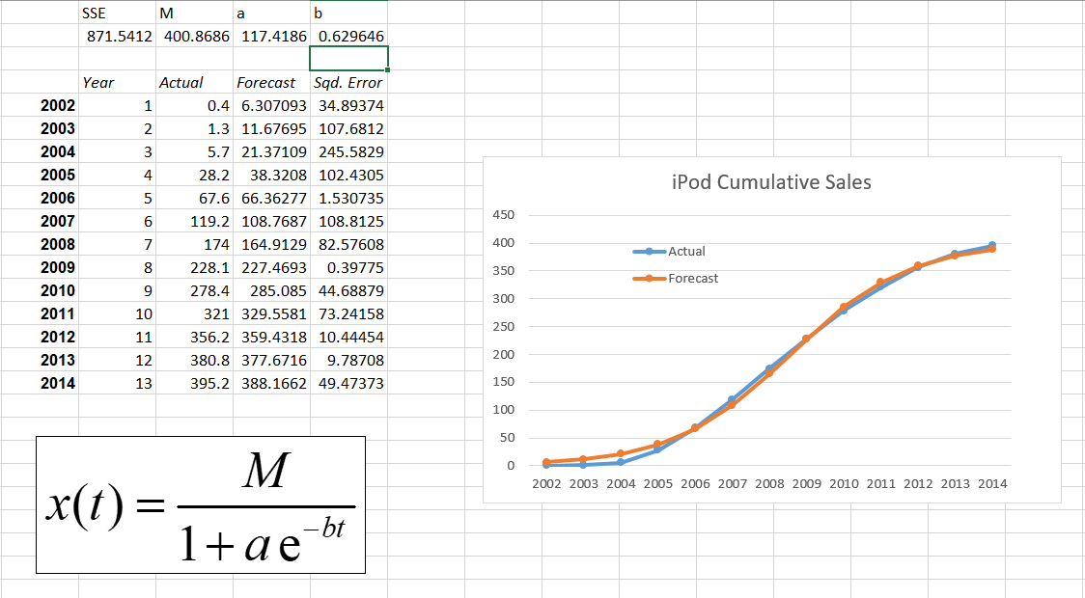
MARKET SIZING AND NEW PRODUCT ADOPTION
iPod Sales

Slide 14
MARKET SIZING AND NEW PRODUCT ADOPTION
iPod Sales
Some interesting observations about the inflection point (where cumulative sales change from increasing at an increasing rate to increasing at a decreasing rate
In terms of time t: [ln(a)]/b=7.57
In terms of cumulative sales M: M/2=200.43

Slide 15
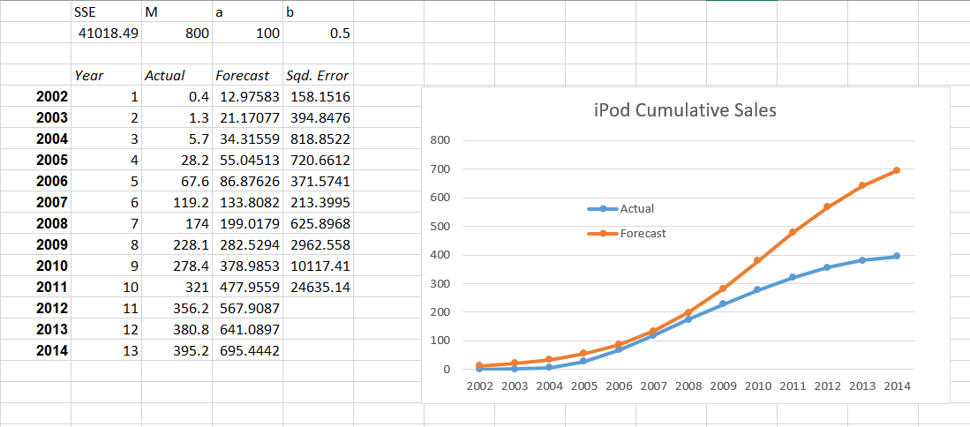
MARKET SIZING AND NEW PRODUCT ADOPTION
Let’s Estimate with 2002-2011 and Forecast 2012-2014
Here we are only using 2002-2011 to fit the curve
We will then forecast last three years

Slide 16
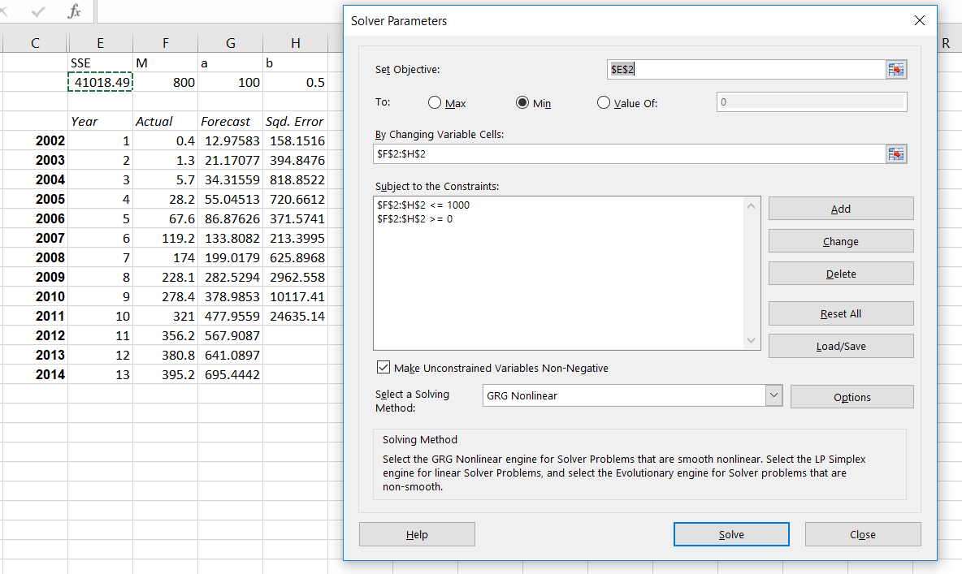
MARKET SIZING AND NEW PRODUCT ADOPTION
Let’s Estimate with 2002-2011 and Forecast 2012-2014

Slide 17
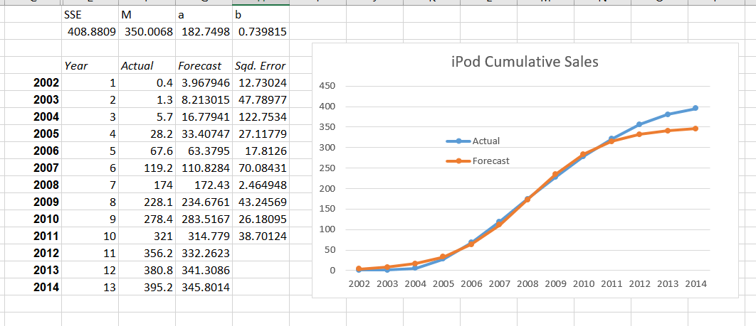
MARKET SIZING AND NEW PRODUCT ADOPTION
Let’s Estimate with 2002-2011 and Forecast 2012-2014
The Pearl curve forces symmetry between the left and right tails
Why might symmetry not hold?

Slide 18
MARKET SIZING AND NEW PRODUCT ADOPTION
CURVE FITTING
Cumulative sales of a product
Gompertz Curve
M is market size
a and b are parameters
t is time

Slide 19
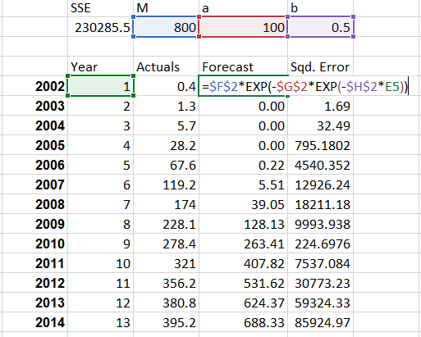
MARKET SIZING AND NEW PRODUCT ADOPTION
iPod Sales

Slide 20
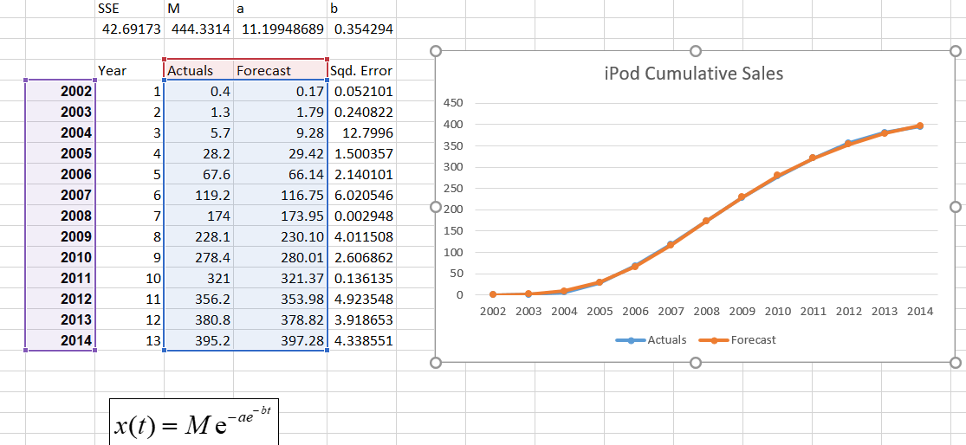
MARKET SIZING AND NEW PRODUCT ADOPTION
iPod Sales

Slide 21
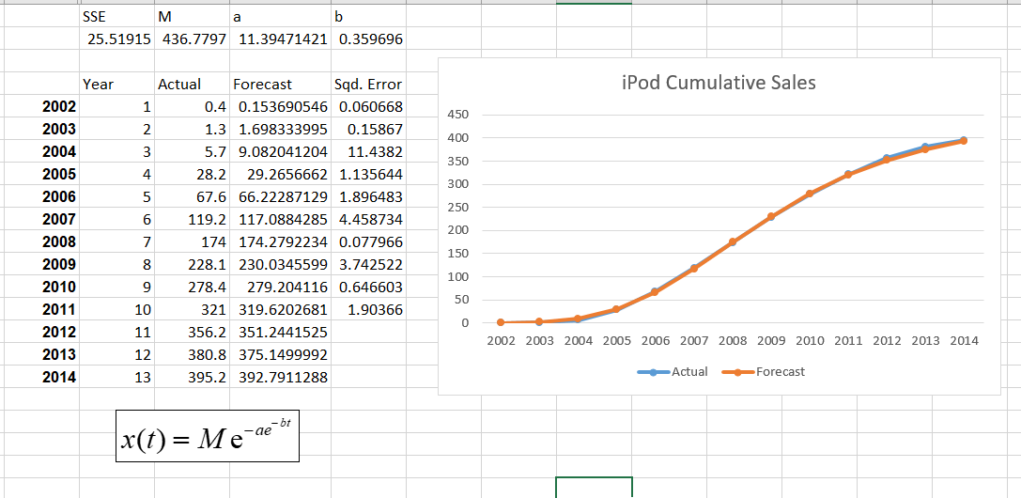
MARKET SIZING AND NEW PRODUCT ADOPTION
iPod Sales
Some interesting observations about the inflection point (where cumulative sales change from increasing at an increasing rate to increasing at a decreasing rate
In terms of time t: [ln(a)]/b=6.82
In terms of cumulative sales M: M/exp(1)=163.46

Slide 22
MARKET SIZING AND NEW PRODUCT ADOPTION
Let’s Estimate with 2002-2011 and Forecast 2012-2014
Here we are only using 2002-2011 to fit the curve
We will then forecast last three years

Slide 23
MARKET SIZING AND NEW PRODUCT ADOPTION
Let’s Estimate with 2002-2011 and Forecast 2012-2014
Gompertz curve more flexible as it does not impose symmetry on the tails

Slide 24
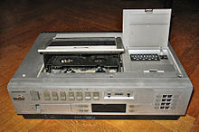
MARKET SIZING AND NEW PRODUCT ADOPTION
A Decade of Sales Data for Two Products

Slide 25
MARKET SIZING AND NEW PRODUCT ADOPTION
Time to Adoption
Let’s say time to adoption is normally distributed with mean 5 and standard deviation 1.
Years
1 2 3 4 5 6 7 8 9

Slide 26
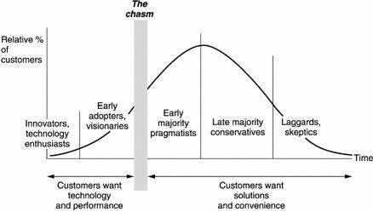
MARKET SIZING AND NEW PRODUCT ADOPTION
When Will Consumer Adopt?

Slide 27
MARKET SIZING AND NEW PRODUCT ADOPTION
When Will Consumer Adopt?
INNOVATORS
IMITATORS

Slide 28


MARKET SIZING AND NEW PRODUCT ADOPTION
Bass Model of Product Diffusion
Social System
Innovators
Imitators

Slide 29
MARKET SIZING AND NEW PRODUCT ADOPTION
A Model with Innovators and Imitators
Number of potential adopters at t
Probability of Adoption at t
Innovators
Imitators

Slide 30
MARKET SIZING AND NEW PRODUCT ADOPTION
Notation for Diffusion Model
Notation for the model
N(t): total number of adopters at the current time period (period t)
N(t-1): total number of adopters at the previous time period (period t-1)
S(t): number of adopters at the current time period

Slide 31
MARKET SIZING AND NEW PRODUCT ADOPTION
Notation for Diffusion Model
Parameters of the Bass Diffusion Model
m: total market size
p: coefficient of innovation
q: coefficient of imitation
Likelihood of purchase by new adopter at time t

Slide 32
MARKET SIZING AND NEW PRODUCT ADOPTION
We need an expression for sales
Probability of Adoption at t
Number of potential adopters at t

Slide 33
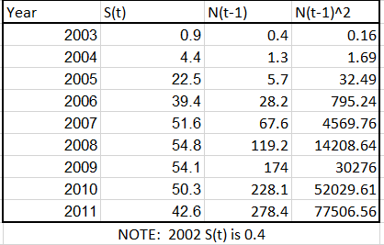
MARKET SIZING AND NEW PRODUCT ADOPTION
Something Look Familiar Here?

Slide 34
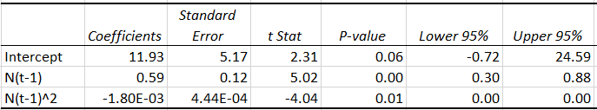
MARKET SIZING AND NEW PRODUCT ADOPTION
Some Models…

Slide 35
MARKET SIZING AND NEW PRODUCT ADOPTION
A Decade of Sales Data for Two Products

Slide 36
MARKET SIZING AND NEW PRODUCT ADOPTION
Recovering estimates of p, q, and m from a, b, and c

Slide 37
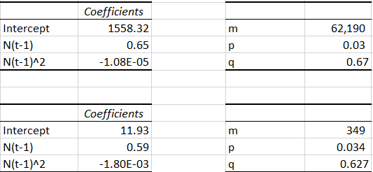
MARKET SIZING AND NEW PRODUCT ADOPTION
A Decade of Sales Data for Two Products
NOTE: a, b, and c are the regression coefficients on Intercept, N(t-1) and N(t-1)^2

Slide 38
MARKET SIZING AND NEW PRODUCT ADOPTION
Now that I know p, q, and m what can I do?
Timing of the peak sales
Sales level at the peak

Slide 39
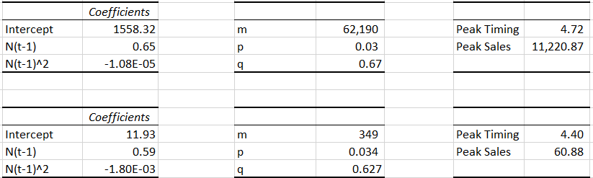
MARKET SIZING AND NEW PRODUCT ADOPTION
A Decade of Sales Data for Two Products
NOTE: a, b, and c are the regression coefficients on Intercept, N(t-1) and N(t-1)^2
Peak timing and sales computed using formulas on slide 37

Slide 40
MARKET SIZING AND NEW PRODUCT ADOPTION
A Decade of Sales Data for Two Products

Slide 41
MARKET SIZING AND NEW PRODUCT ADOPTION
Decomposing Adoptions due to Innovators and Imitators
Probability of Adoption at t
Number of potential adopters at t

Slide 42
MARKET SIZING AND NEW PRODUCT ADOPTION
Decomposing Adoptions due to Innovators and Imitators
Sales due to Innovators
Depends on p, but not q
Strictly declining
Sales due to Innovators
Depends on q, but not p
Rises, peaks, then declines

Slide 43
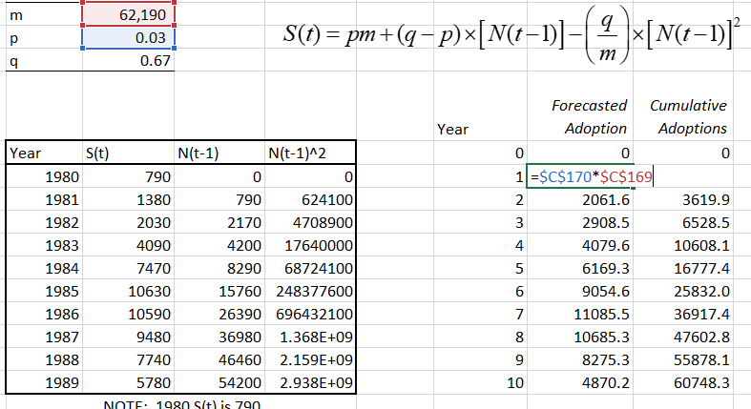
MARKET SIZING AND NEW PRODUCT ADOPTION
Let’s Forecast Adoption: First Period

Slide 44
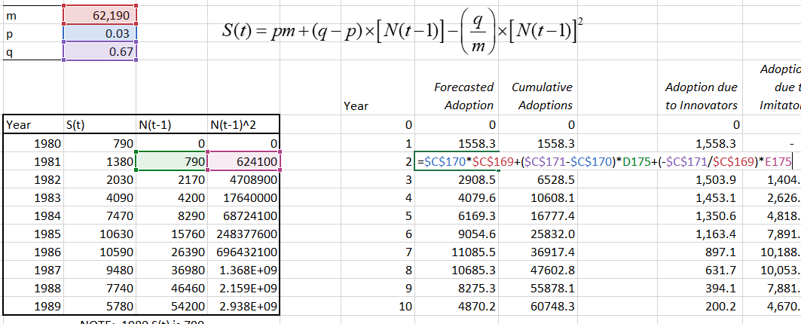
MARKET SIZING AND NEW PRODUCT ADOPTION
Let’s Forecast Adoption: Second Period

Slide 45
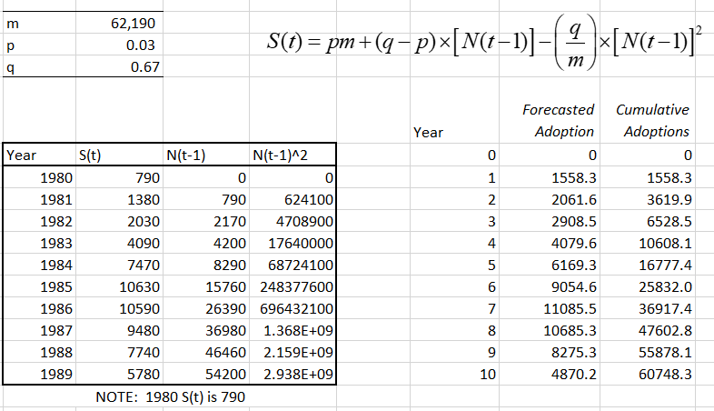
MARKET SIZING AND NEW PRODUCT ADOPTION
Let’s Forecast Adoption: VCR Data

Slide 46
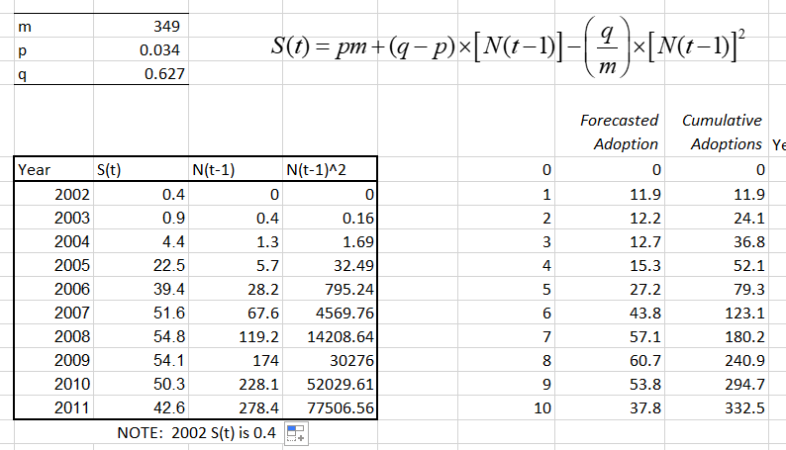
MARKET SIZING AND NEW PRODUCT ADOPTION
Let’s Forecast Adoption: iPod Data

Slide 47
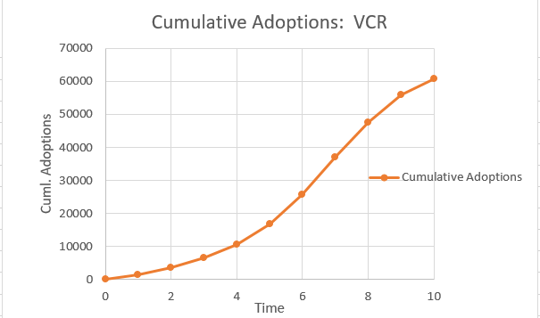
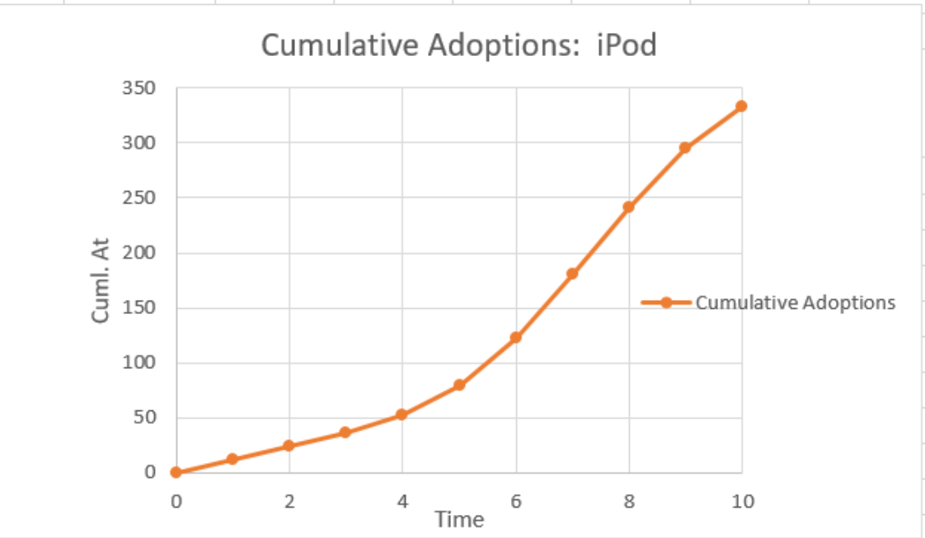
MARKET SIZING AND NEW PRODUCT ADOPTION
Let’s Forecast Adoption

Slide 48
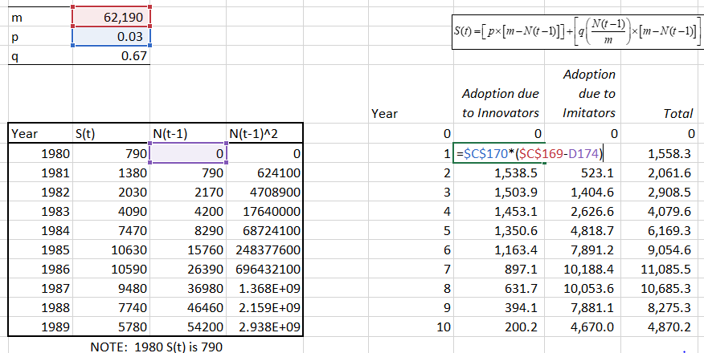
MARKET SIZING AND NEW PRODUCT ADOPTION
Adoption by Innovators

Slide 49
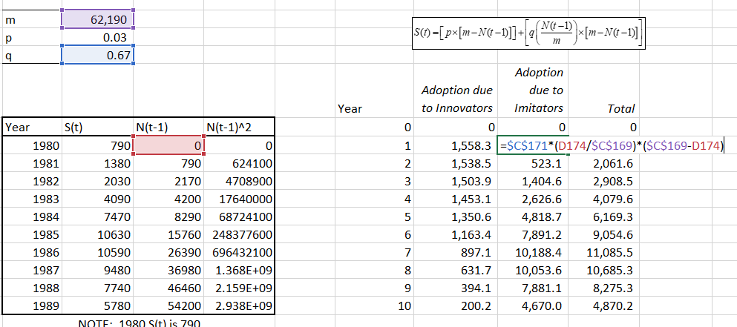
MARKET SIZING AND NEW PRODUCT ADOPTION
Adoption by Imitators

Slide 50
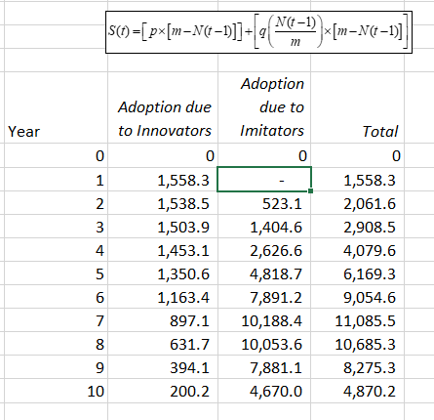
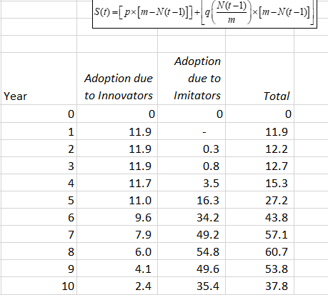
MARKET SIZING AND NEW PRODUCT ADOPTION
Adoption by Innovators and Imitators

Slide 51
MARKET SIZING AND NEW PRODUCT ADOPTION
Total Adoption, Adoption by Innovators, Adoption by Imitators

Slide 52




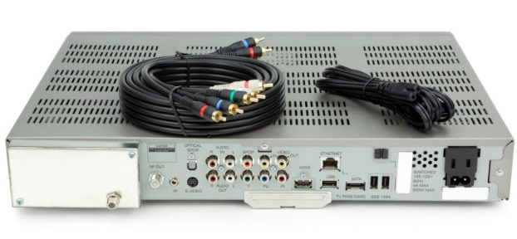

MARKET SIZING AND NEW PRODUCT ADOPTION
Building a Forecast When it is Useful to Have a Forecast
Time

Slide 53



Slide 54
XM SATELLITE RADIO
Demand and Demand Elasticities

Slide 55
XM SATELLITE RADIO
Looking at Monthly Service Revenues
Monthly Subscription Rev. ($MM)

Slide 56
XM SATELLITE RADIO
Using the model to forecast adoption timing
Estimate market potential m for the new innovation through management judgment or survey research
Select analogous products for which a fairly complete diffusion history is available
Obtain the diffusion model parameters for innovation and imitation for these products

Slide 57
XM SATELLITE RADIO
Using the model to forecast adoption timing
Build a model that yields a five year forecast for cumulative subscribers prior to launch
Use an m of 30MM
You could start with p=0.03 and q=0.38 (historic averages)
Or use the average p and q from list

Slide 58
XM SATELLITE RADIO
A Model
Recall that N(t-1) is the cumulative sales at time (t-1)
You have p, m, and q
To start, N(t-1) is 0
So sales in first period is p x m
Roll forward to second period (t=2)
N(t-1) is sales from first period
Compute sales in second period
Roll forward to third period (t=3)
N(t-1) is cumulative sales from 1st and 2nd periods

Slide 59
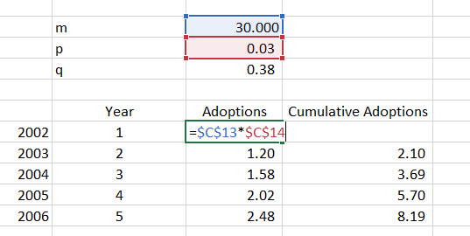
XM SATELLITE RADIO
A Model
Recall that N(t-1) is the cumulative sales at time (t-1)
You have p, m, and q
To start, N(t-1) is 0
So sales in first period is p x m

Slide 60
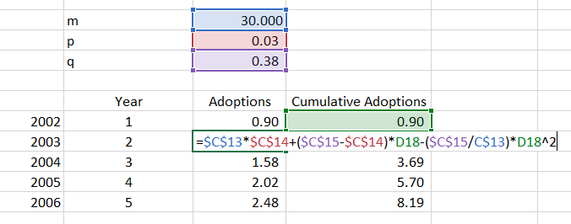
XM SATELLITE RADIO
A Model
Recall that N(t-1) is the cumulative sales at time (t-1)
You have p, m, and q
Roll forward to second period (t=2)
N(t-1) is sales from first period
Compute sales in second period

Slide 61
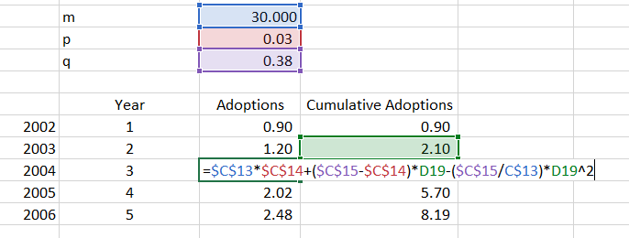
XM SATELLITE RADIO
A Model
Recall that N(t-1) is the cumulative sales at time (t-1)
You have p, m, and q
Roll forward to third period (t=3)
N(t-1) is cumulative sales from 1st and 2nd periods

Slide 62
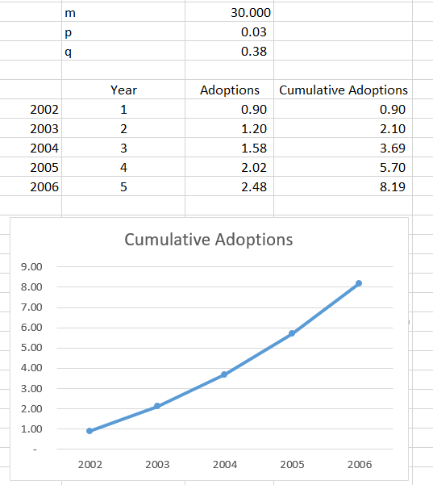
XM SATELLITE RADIO
Build up forecast
Using historic average p and q

Slide 63
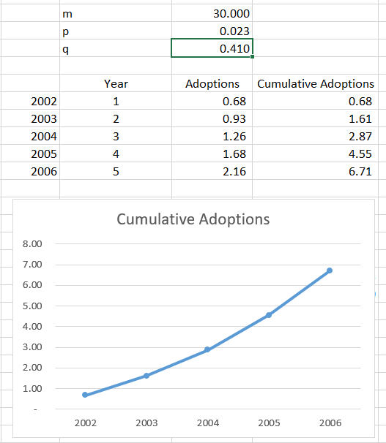
XM SATELLITE RADIO
Build Up Forecast
Using average p and q from 4 products

Slide 64
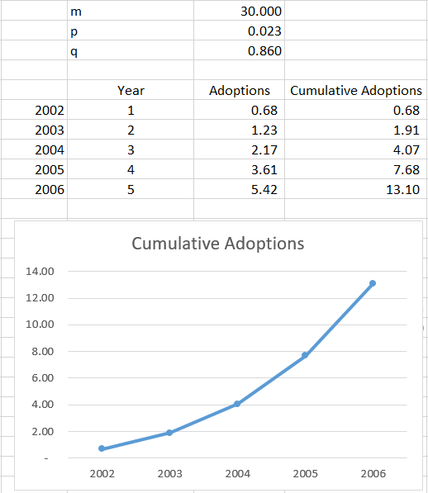
XM SATELLITE RADIO
Build up forecast
Using higher q to reflect wait and see approach

Slide 65
XM SATELLITE RADIO
Actuals (in Orange) vs. Forecast (In Blue)

Slide 66
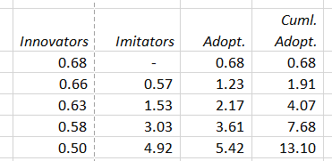
XM SATELLITE RADIO
Source of Sales
Decomposing Sales due to Innovators vs. Imitators

Slide 67
XM SATELLITE RADIO
What Happened?
Launch date set for Sept 12th , 2001
Launch postponed to Sept 25th, 2001
Launched at $9.95 per month
Launched with a mix of ads depending on channels
$100MM ad campaign supports launch
28,000 paid subscribers at the end of Q4 2001
376,947 paid subscribers at the end of Q4 2002
Sirius launches in July 2002 at $12.95 and commercial free
30,000 paid subscribers at the end of Q4 2002
Sirius XM hits ~35 million paid subscribers at end of 2019

